Slide 1
Stock Price Prediction with Media Sentiment
sc5124 Shengqi Cao
jh4312 Jingchao Hu
wx2283 Wenshuo Xie

Slide 2
Goal & Novelty
Goal:
Our goal is to create a model that provides accurate and reliable predictions about stock prices to assist with investment decision-making.
Build a model that can predict stock prices using sentiment analysis on Twitter data.
Estimate the “market sentiment” based on the “public sentiment” and then predict the stock trend.
Novelty:
Our novelty is connecting the public sentiment with the stock price, and the use of different techniques to improve the accuracy and interpretability of the model.

Slide 3
Data
Tweets about the Top Companies from 2015 to 2020
Volume: Over 3 million rows of unique tweets data
Velocity: We performed a one-time scraping to collect the data, it contains tweets about top companies from 2015 to 2020
Variety: 7 columns, including tweet id, author of the tweet, post date, the text body of the tweet, and the number of comments, likes, and retweets
Values of Top NASDAQ Companies from 2010 to 2020
Volume: About 17,500 rows of stock price data
Velocity: We performed a one-time scraping to collect the data, it contains stock price data of top companies from 2010 to 2020
Variety: 7 columns, including ticker symbol, day date, close value, volume, open value, high value, low value
Twitter7 dataset(from Stanford Large Network Dataset Collection)
Volume: 467 million Twitter posts from 20 million users
Velocity: It’s an existing dataset. It contains data covering a 7 month period from June 1 2009 to December 31 2009
Variety: 7 columns, including tweet id, author of the tweet, post date, the text body of the tweet, and the number of comments, likes, and retweets
Historical stock price dataset
Volume: About 15,000 rows of stock price data
Velocity: It’s an existing dataset. It contains stock price data of top companies in 2009
Variety: 7 columns, including ticker symbol, day date, close value, volume, open value, high value, low value

Slide 4
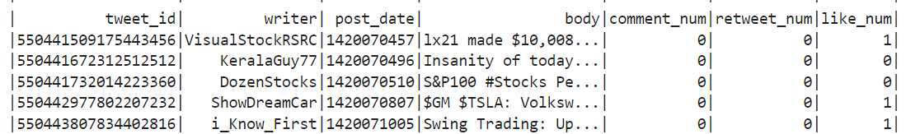
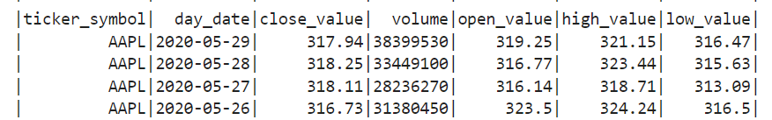
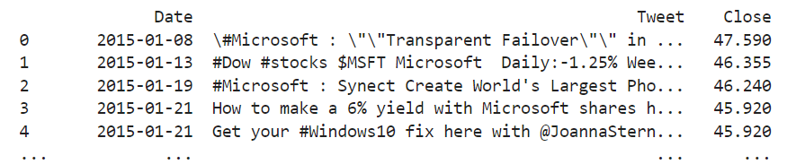
Methodology
Data Pre-processing:
Load the data csv file into the Google Cloud storage bucket, and use Pyspark to read it, then we parse and filter the data.
Sentiment Analysis:
Used the vader_lexicon in the NLTK package in Python to conduct sentiment analysis on the twitter data, obtaining the polarity of the tweets for each day.

Slide 5
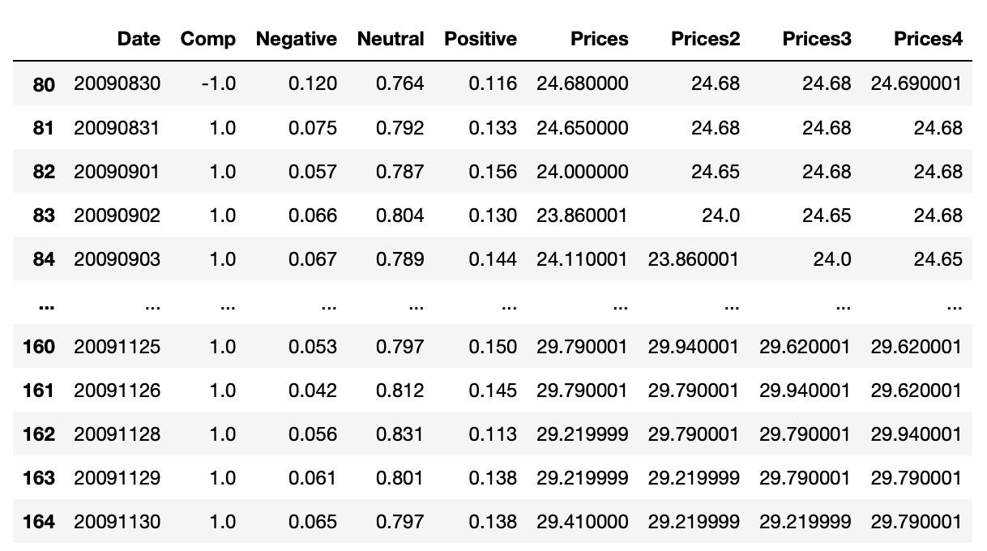
Methodology
Model Training and evaluation:
Trained and evaluated machine learning models (linear regression, random forest, and multilayer perceptron) on the processed data
Training Sets

Slide 6
Algorithm
Linear regression:
Modeled the relationship between sentiment data from twitter and stock prices.
Random forest:
Used an ensemble learning method to predict stock prices based on twitter sentiment data
Multilayer perceptron (MLP)
Used an artificial neural network to predict stock prices based on twitter sentiment data

Slide 7
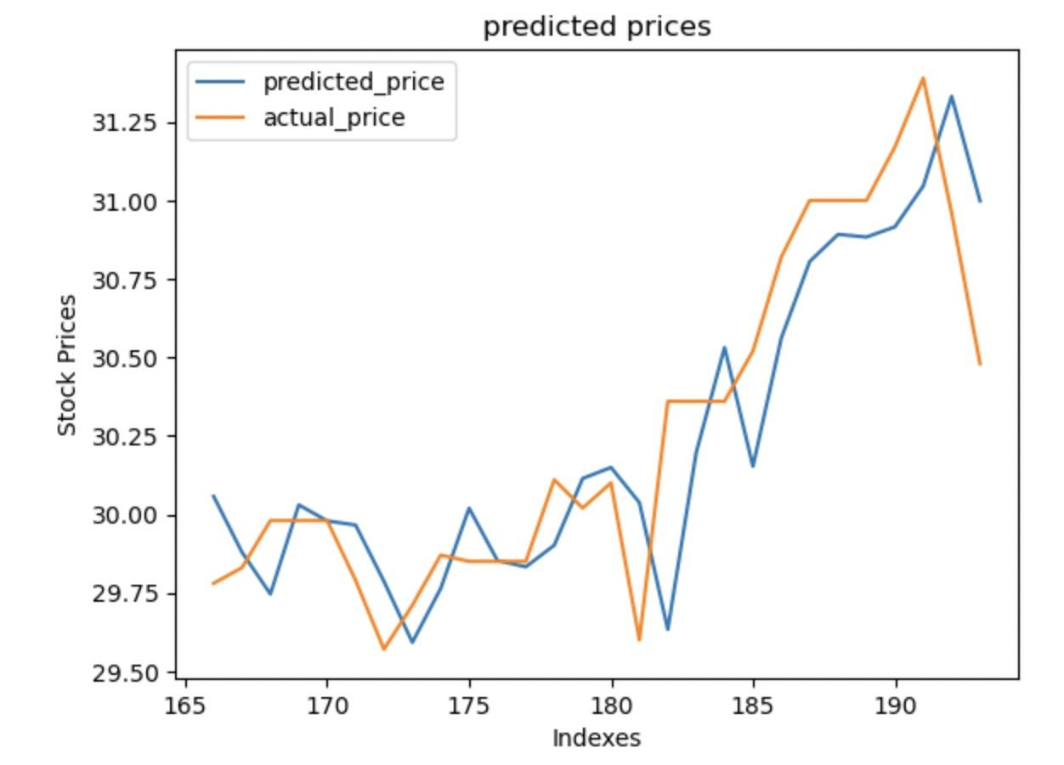
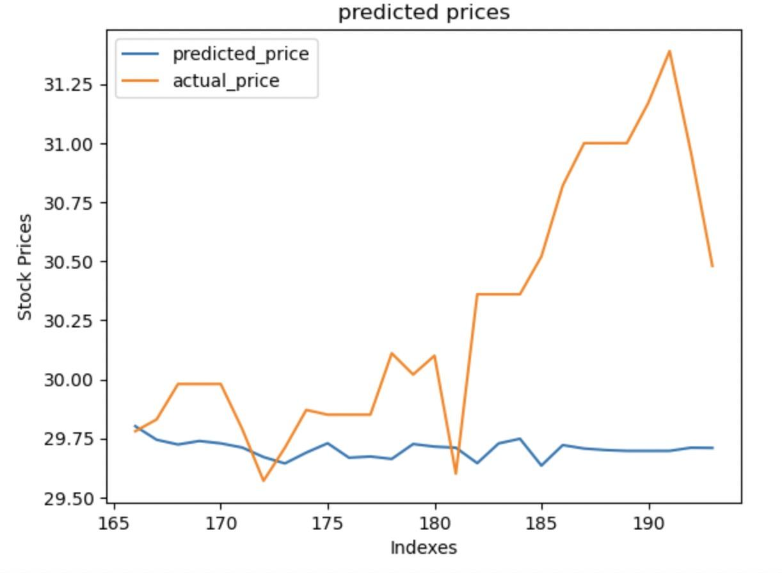
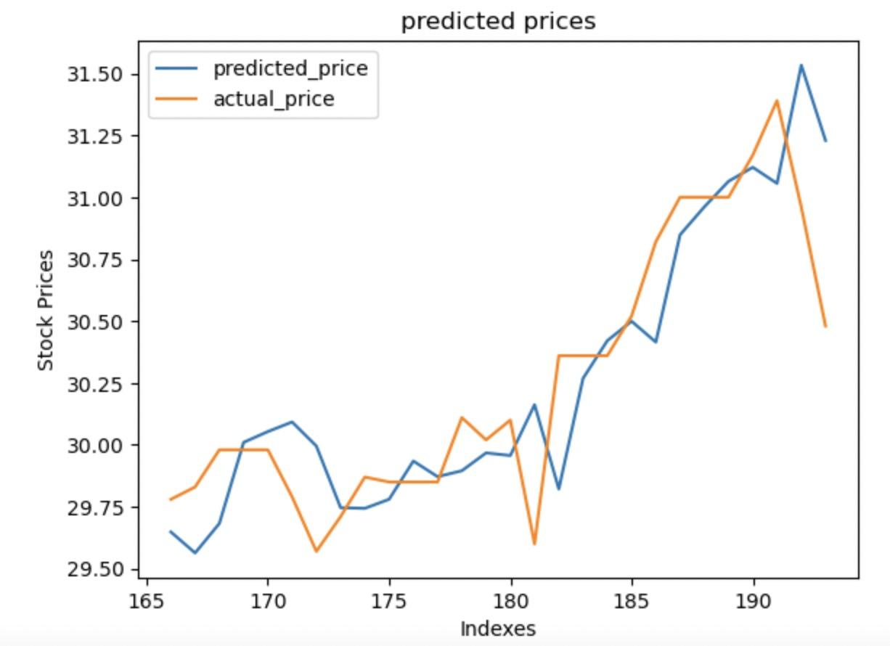
Test Result
Tweet7 dataset
Linear Regression
Random Forest
Multilayer Perceptron

Slide 8
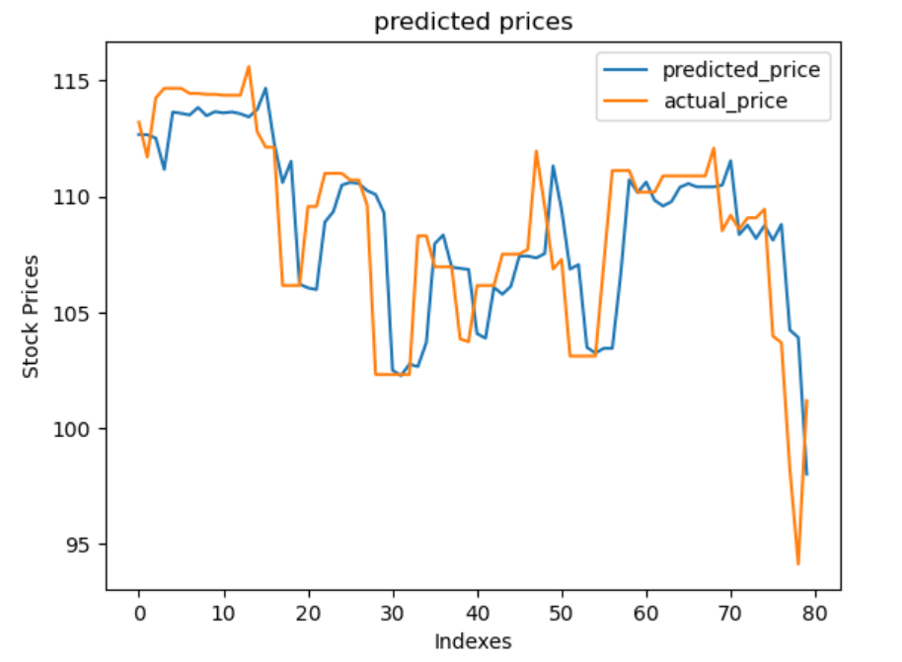
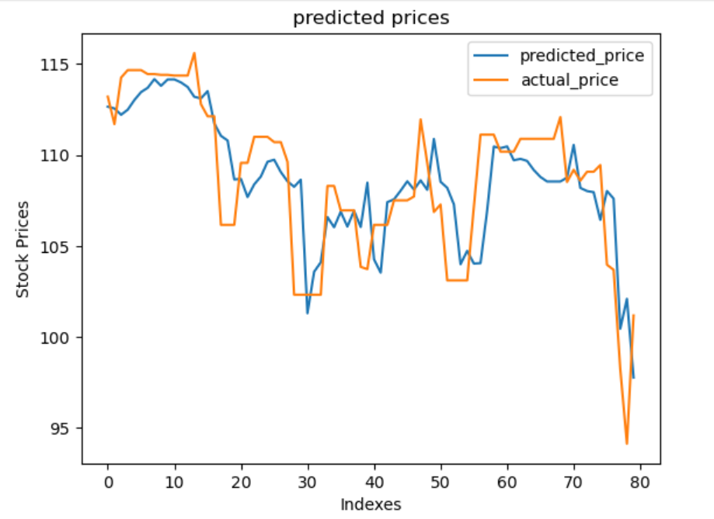
Test Result
New dataset
Linear Regression
Multilayer Perceptron

Slide 9
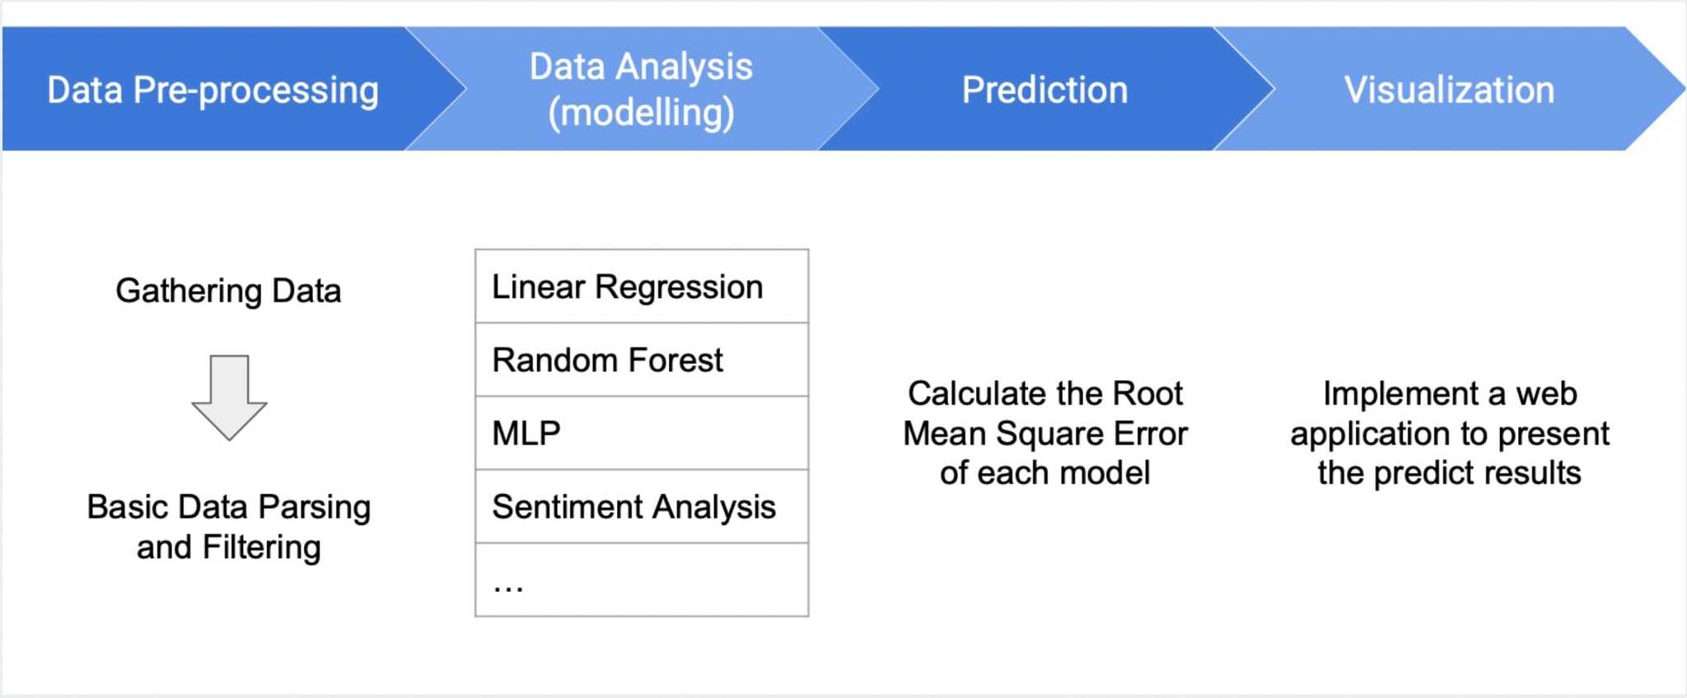
System

Slide 10
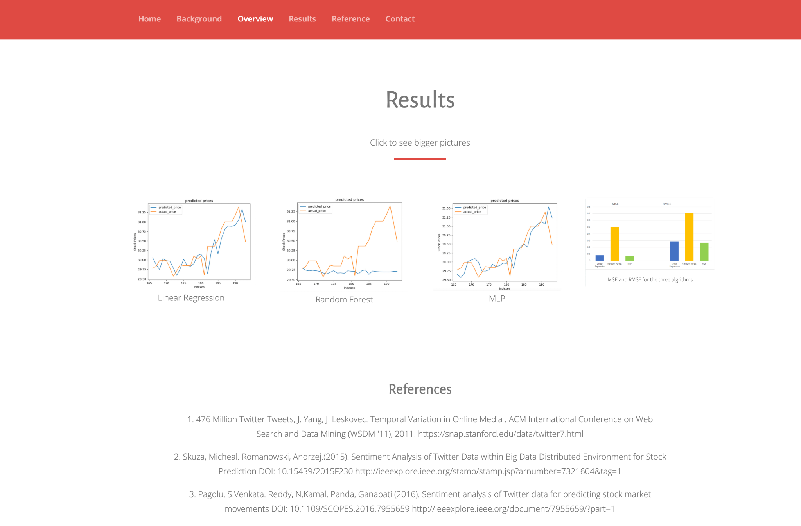
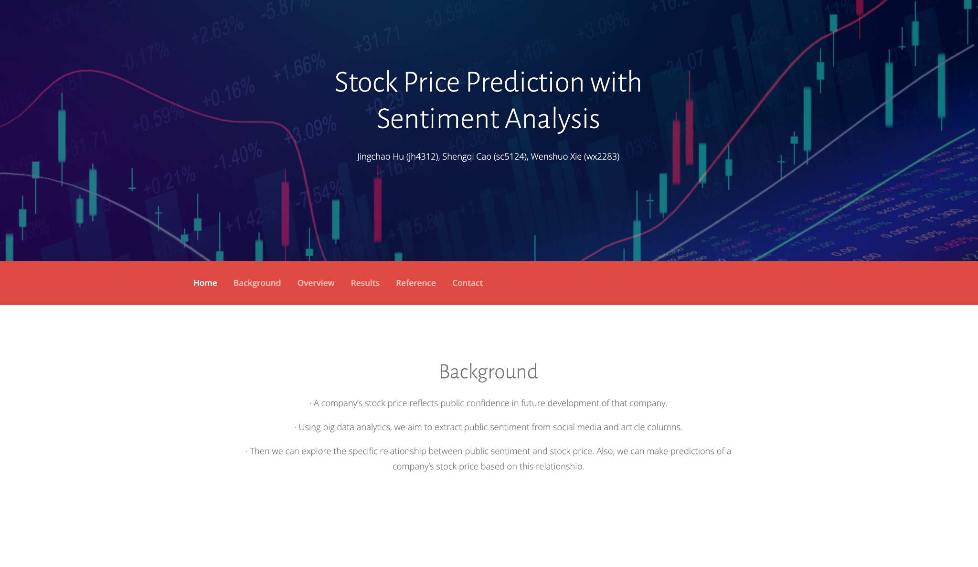
Website Demo

